Slide 2
Bright IDEAS: Leveraging Your Grades Area to Provide Meaningful Feedback

Slide 3
Think
Imagine you are mentoring a new faculty member. What are the important tips you would offer about the Grades area to help your colleague guide student success?

Slide 4
Why?
A well organized and informative Grades area...
For Students
Helps students understand where they stand in the course and what they might need to improve upon.
Provides clarity which reduces confusion and grade disputes
Supports student agency and guides them toward success
For Faculty
Helps faculty identify students in need easily and quickly
Increases efficiency and effectiveness

Slide 5
What
Ways to provide meaningful feedback via the Grades area
Written Feedback – comments, understanding Good Job! Vs. constructive feedback, What is meaningful?
Rubric Feedback – saves time if well crafted. Still provides the opportunity for personalization via comments
Inline Feedback – dropbox assignments (annotations)

Slide 6
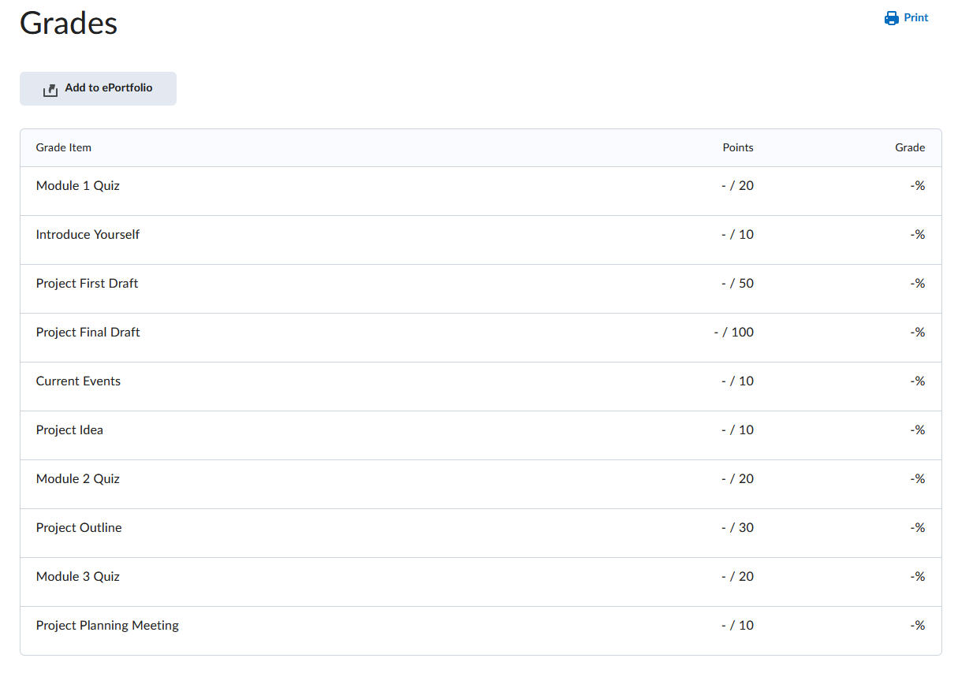
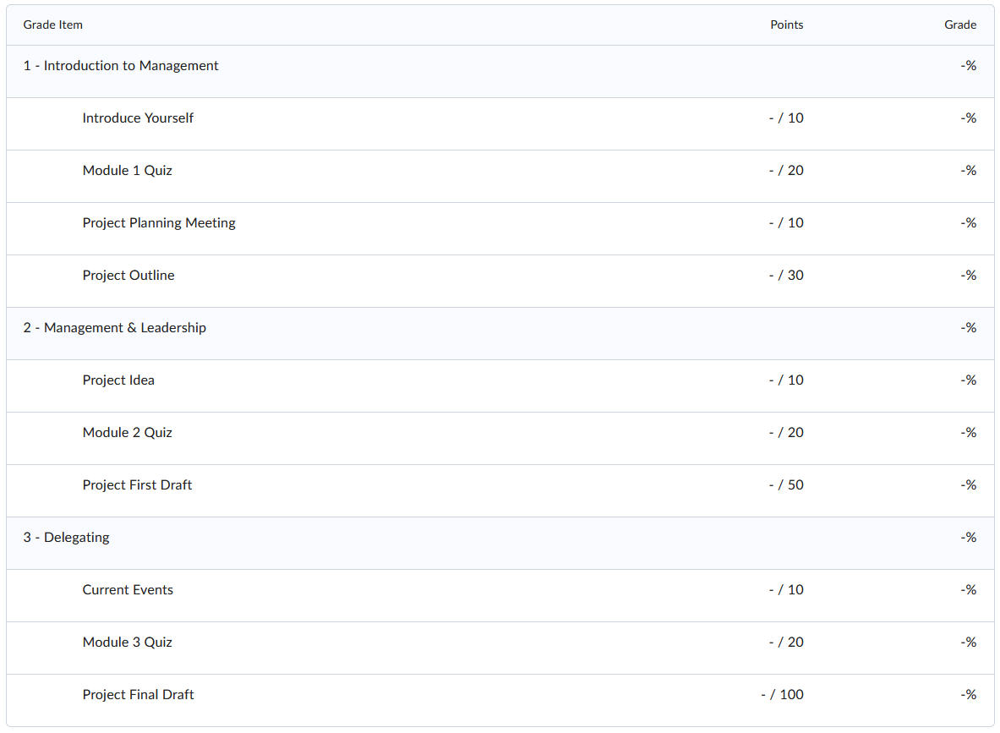
Random Order
Organized by Module

Slide 7
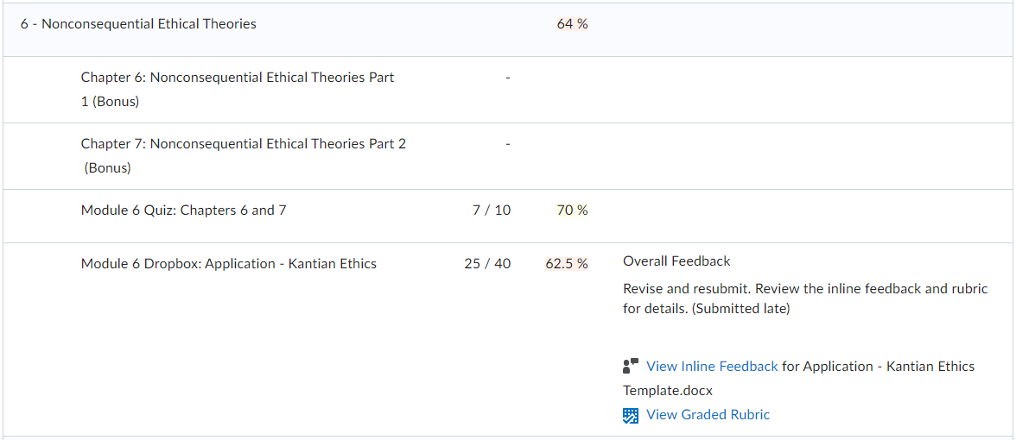

Slide 8
Meaningful Feedback
Timely
Focuses on a skill or specific knowledge
Instructional
Cordial
Actionable - understandable
Sensitive to the individual needs of the student
Keeps students “on target” for achievement
Provides a model or example, and/or references that can assist student

Slide 9
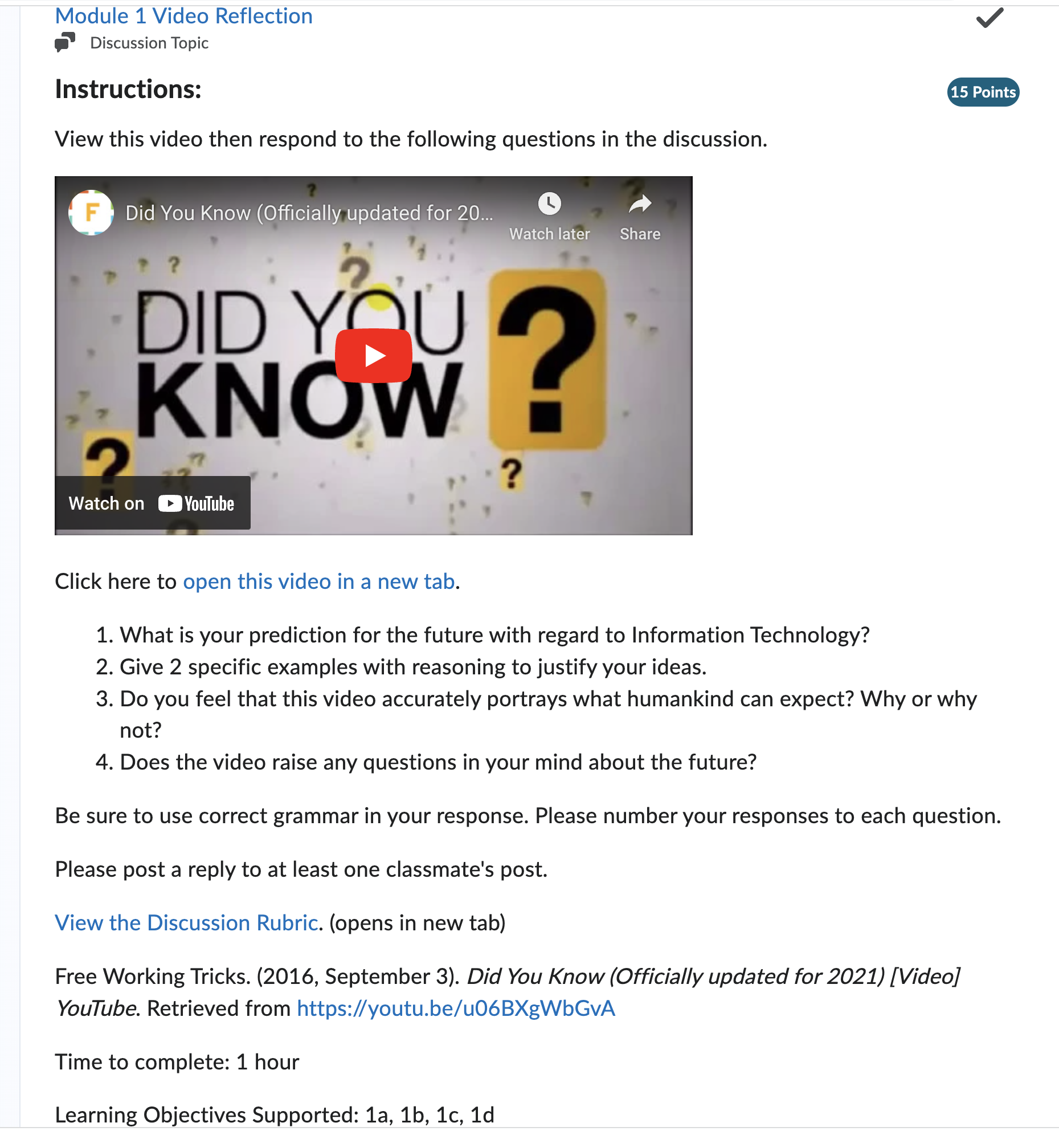
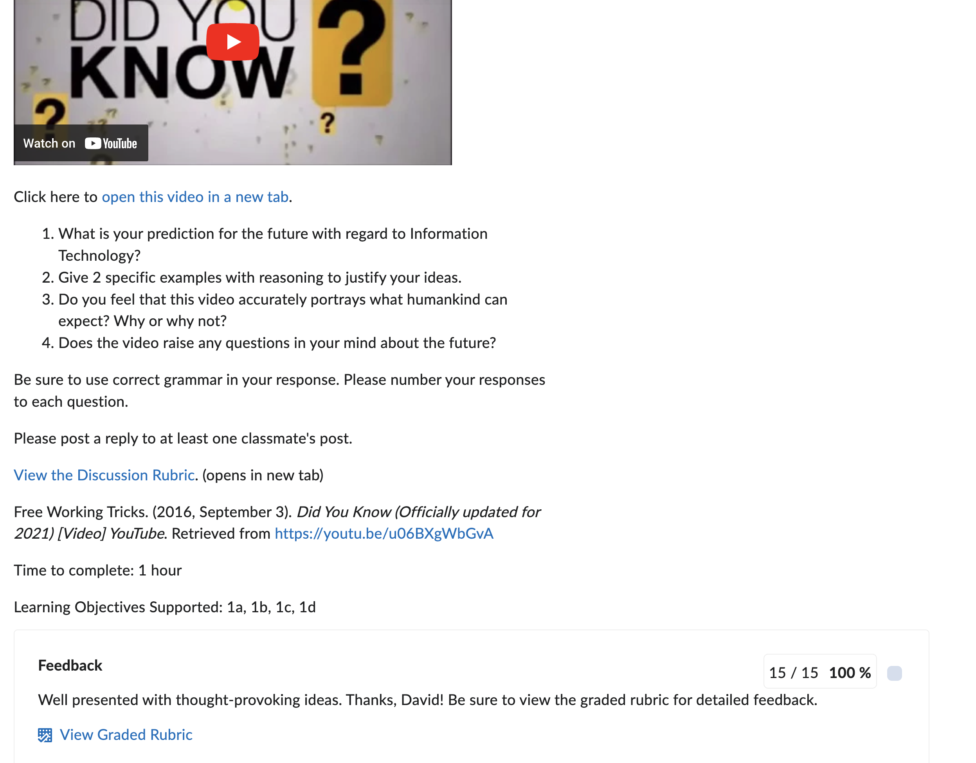
Rubric Feedback – Instructional

Slide 10
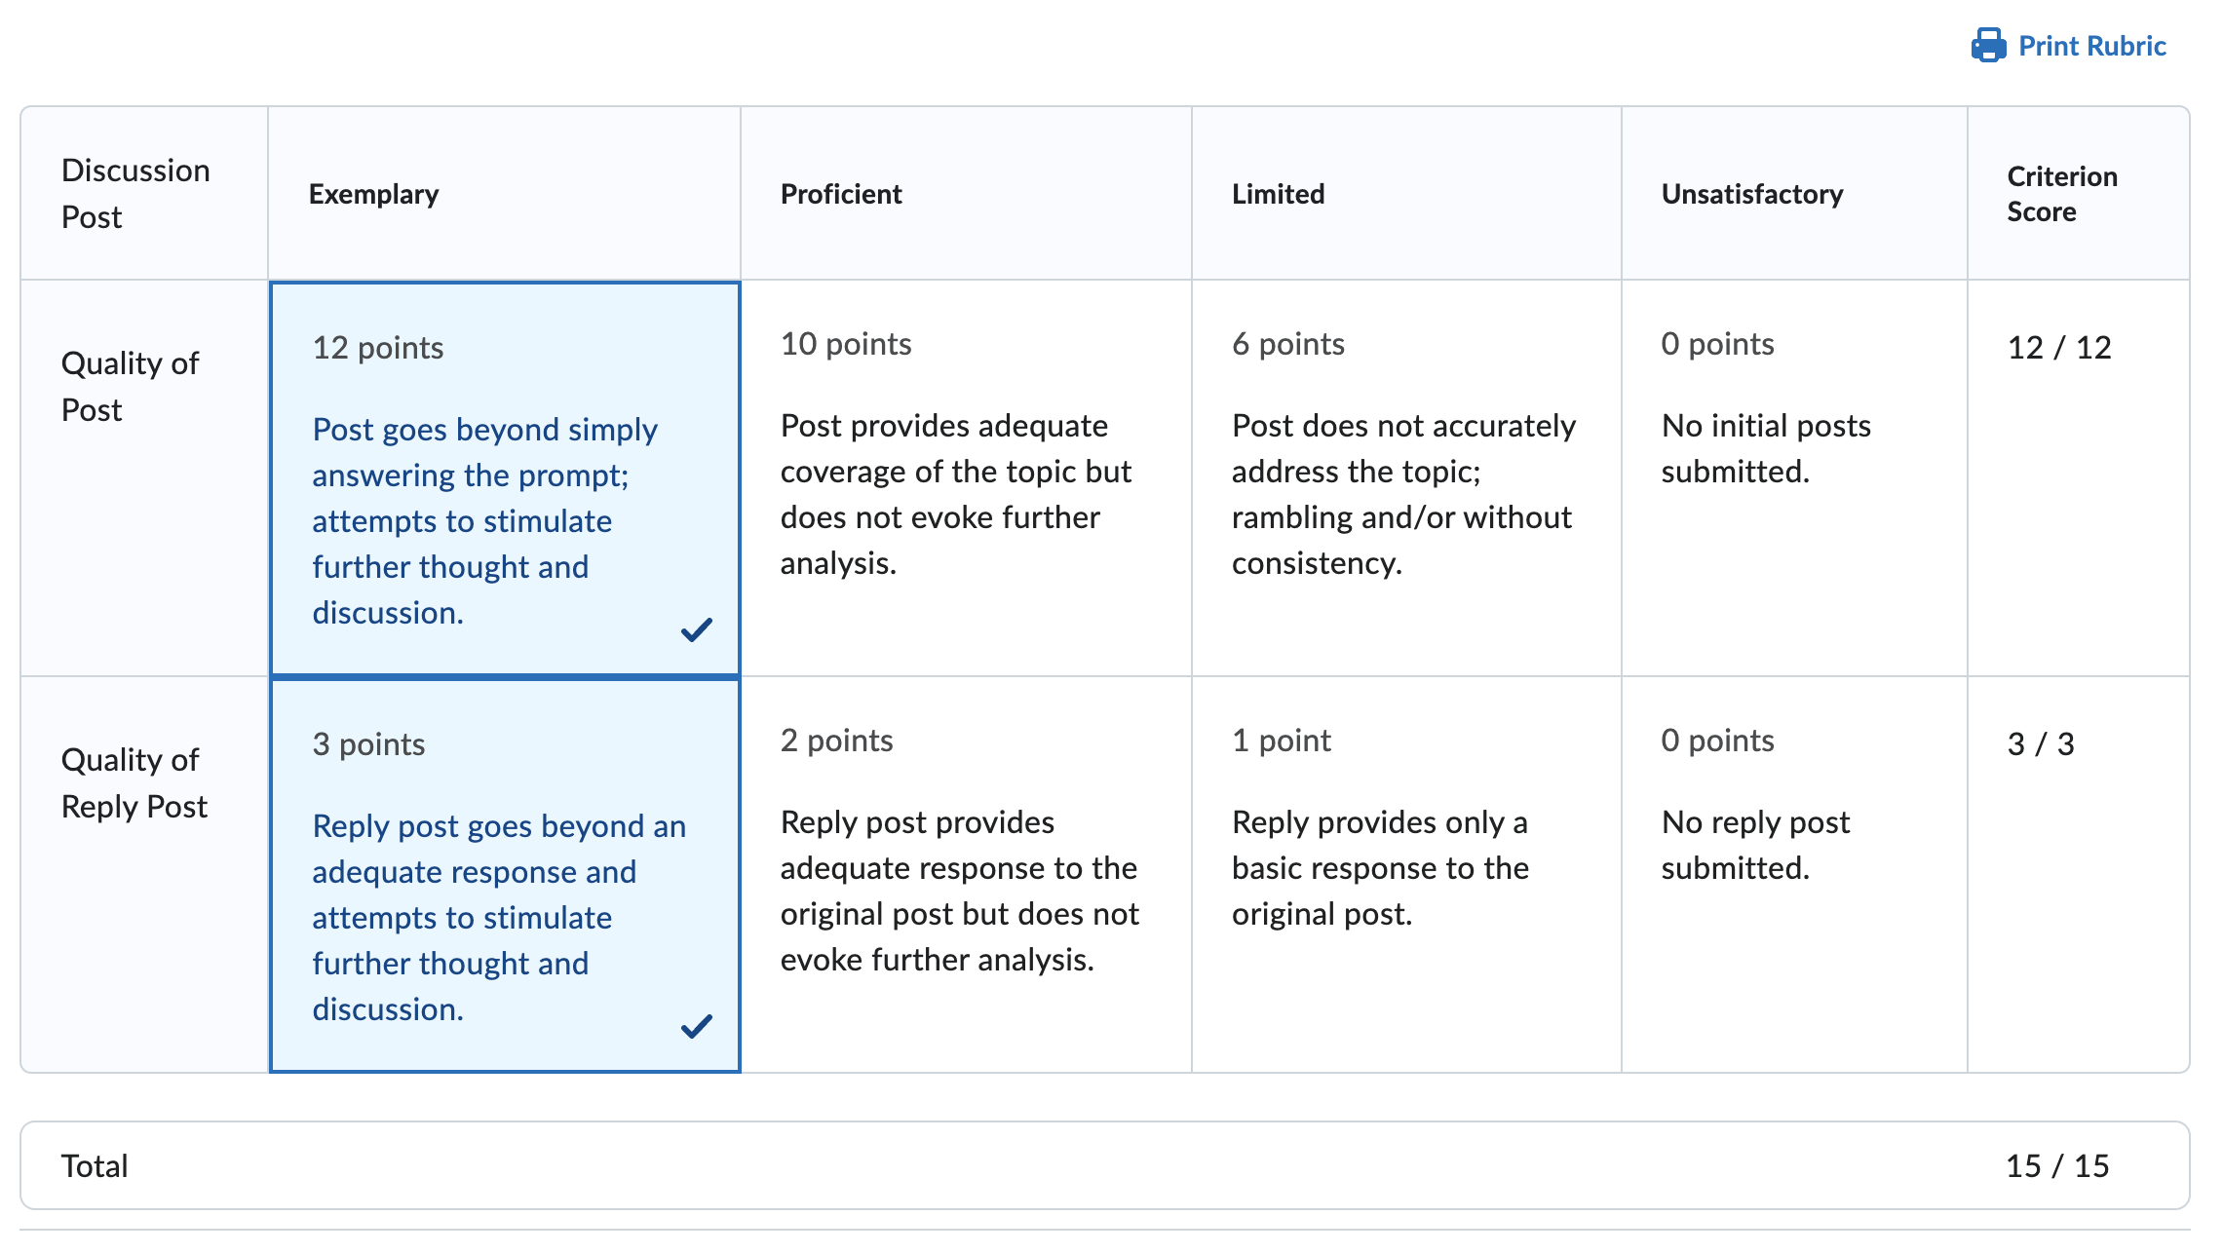
Rubric Feedback – The Student Perspective

Slide 11
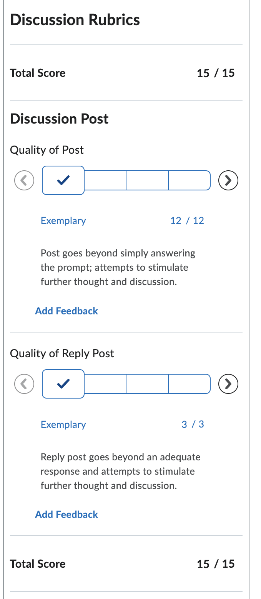
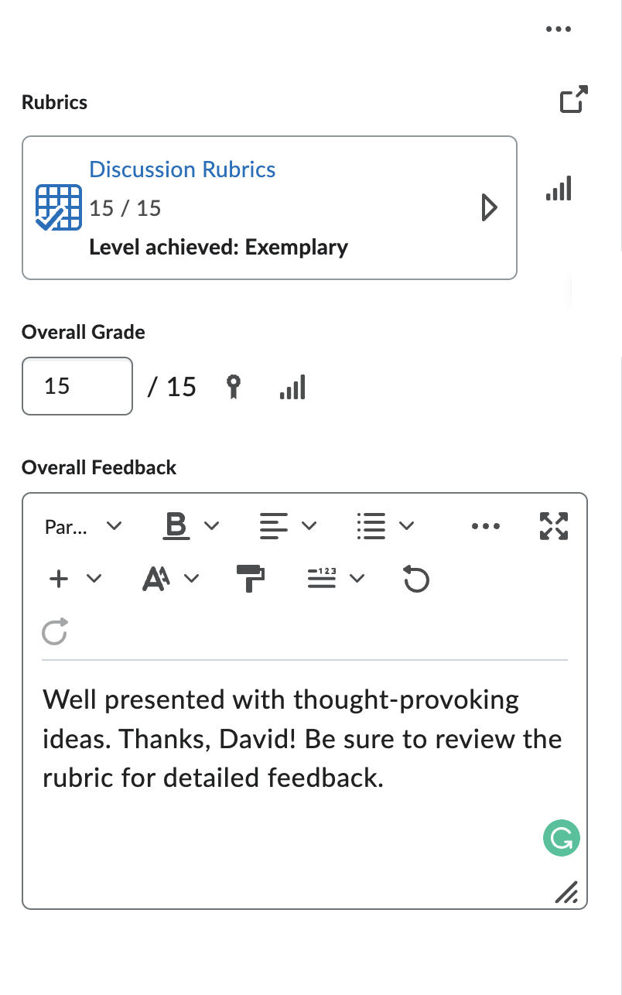
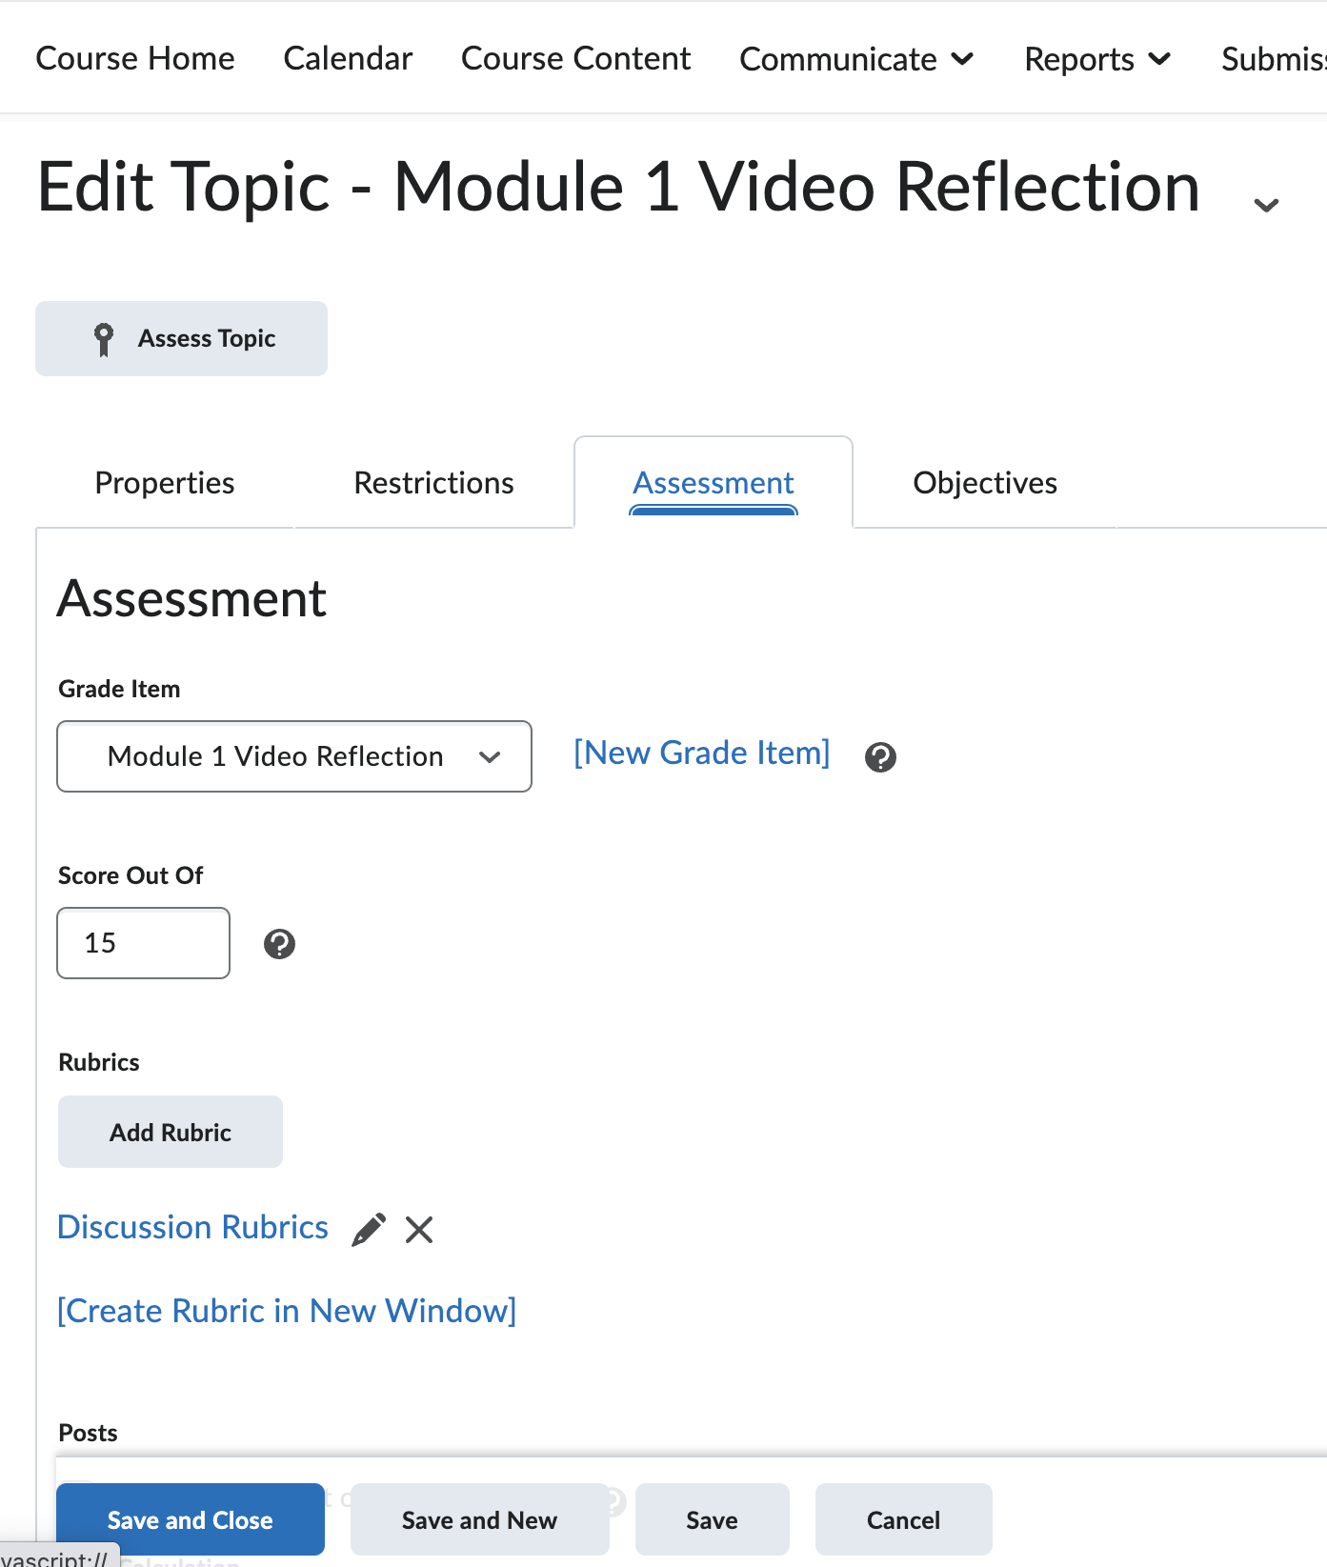
Rubric Feedback – The Faculty Perspective

Slide 12
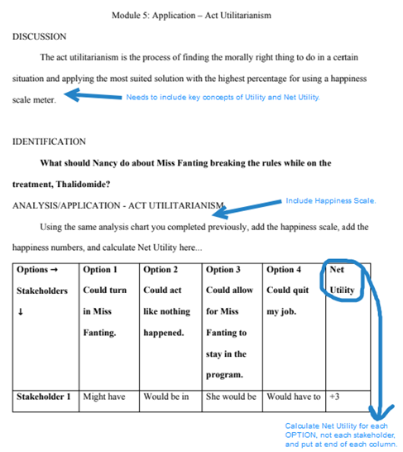
Inline Feedback

Slide 14
Share
We asked you to imagine that you are mentoring a new faculty member and to identify the important tips you would offer about the Grades area.
How has what you originally thought shifted based on today's presentation?

Slide 15
Wrap Up
Topic | Webinar | Coffee or the Cup
Feedback | 10/11/22 | 10/18/22
Alignment | 11/1/22 | 11/8/22
Year-End Wrap | 12/6/22 (combined)
Student Agency | 1/24/23 | 1/31/23
Community-Building | 2/21/23 | 2/28/23
Visual Appeal | 3/21/23 | 3/28/23
Accessibility | 4/18/23 | 4/25/23
Blog posts
Demos
Coffee or the Cup
Email: IDEAS@SPCollege.edu
Website: FacultySupport.SPCollege.edu
And more…

