Slide 2
Bright IDEAS Webinar Alignment: Journey to Student Learning

Slide 3
Objectives for this Webinar
By the end of this session, participants will be able to:
explain what alignment is and why it is essential to student learning
explain the relationship between learning objectives and the levels of thinking (Bloom's taxonomy)
identify examples of effective alignment between assessments and objectives, and suggest improvements.

Slide 4
What is Alignment?
Assessment
Tools
When assessments measure whether students have achieved learning objectives, and when instructional materials, learning activities, and tools help prepare students for the assessments.
Activities
Materials
Learning Objective

Slide 5
Example of Alignment
Learning Objective
6. The student will ethically evaluate sources, including digital content, by:
b. determining the currency, relevance, authority, accuracy, and purpose of sources.
Materials
Websites (reputable and non-reputable)
Activities
Locate reputable websites and explain how each meets the standards of currency, relevancy, authority, accuracy, and purpose.
Tools
"CRAAP Test" template document
Assessment
For the website provided, explain whether it is reputable based upon its currency, relevancy, authority, accuracy, and purpose.

Slide 7
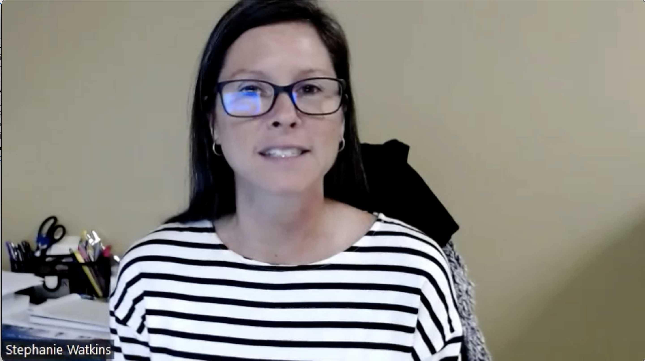
Stephanie Watkins Alignment Journey Video

Slide 8
Why is Alignment Important?
Aligning assessments to learning objectives helps assure that students meet the intended goals of a course.
Alignment validates course outcomes, which in turn ensures SPC, the State of Florida, and Grant standards are being met.
Guarantees that students are being taught what they're supposed to be taught.
Ensures that when a student transfers, their prerequisites or degree from SPC will support them.

Slide 9
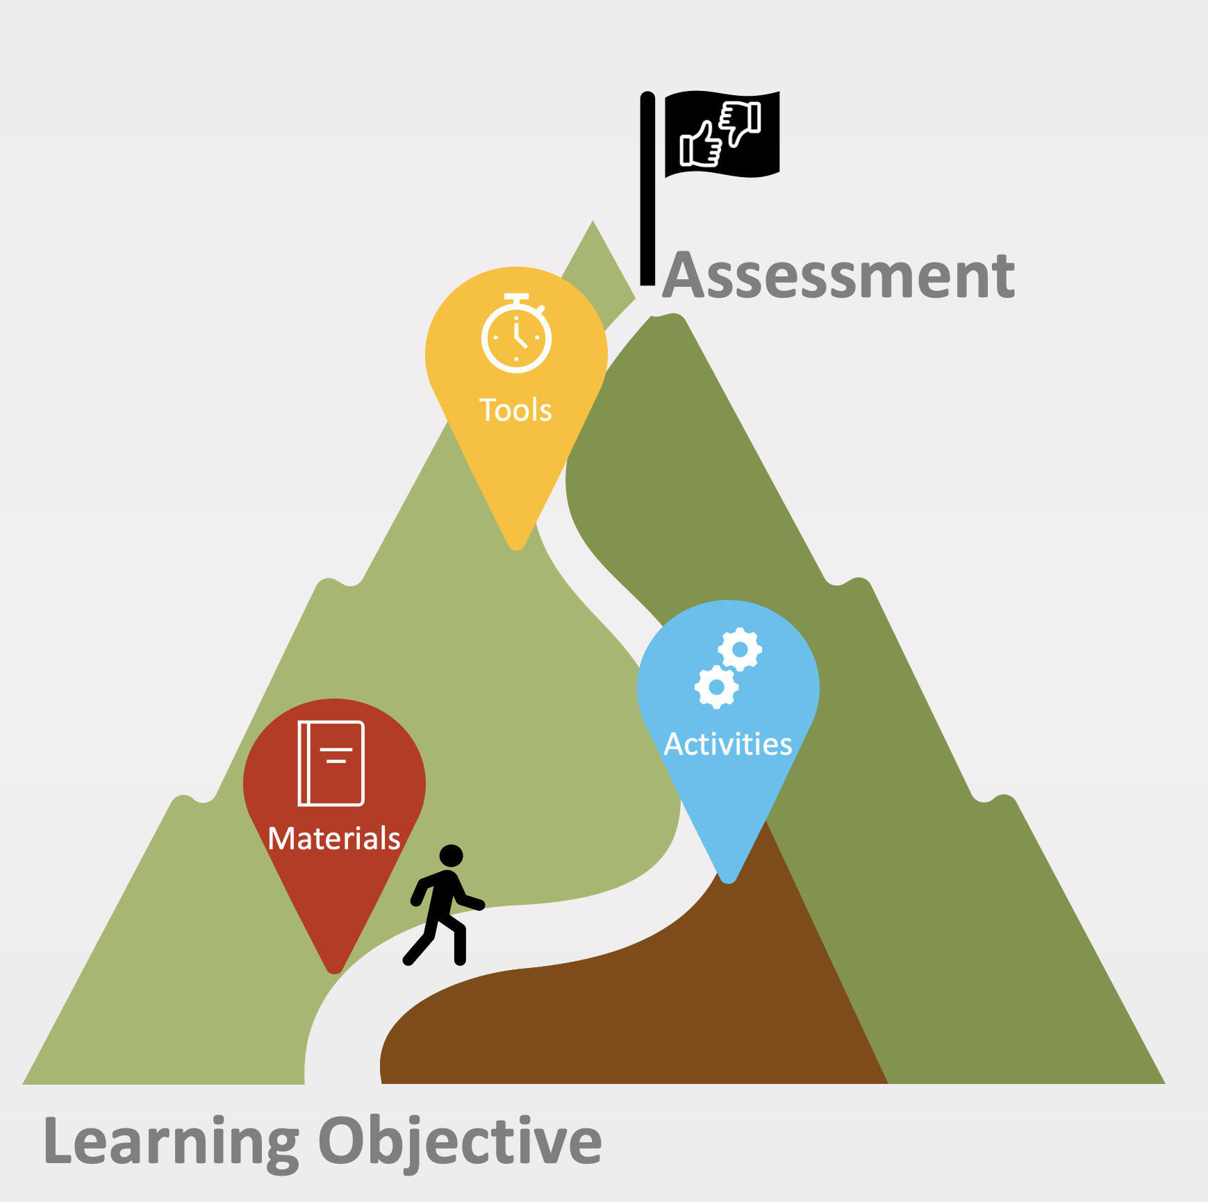
Scenario Activity
Together we will look at three different alignment scenarios
Based on what you have learned today, you will make decisions about the effectiveness of the alignment of each scenario
There will be an opportunity to share your thoughts and create solutions

Slide 10
Scenario One
Major Learning Outcome
1. The student will describe IT security by:
Learning Objective
a. defining computer crime and cyber-crime and providing examples of each
Assessment
Students will watch a video where a CIO explains Company XYZ's cyber-crime policy. In a discussion, students will evaluate the effectiveness of the company's cyber-crime policy and make recommendations for improving it.

Slide 11
Scenario Two
Major Learning Outcome
4. Students will be able to analyze the causes, events, and effects of the Renaissance, Reformation, Scientific Revolution, and Age of Exploration by:
Learning Objective
b. identifying primary criticisms of the Roman Catholic Church by individuals such as Wycliffe, Hus, and Erasmus and their impact on later reforms.
Assessment
Students will be separated into collaborative groups. Each group will be assigned to research and analyze the written and spoken criticisms of the critic they are assigned (Wycliffe, Hus, or Erasmus). Each group will make a presentation to the class on their findings. The presentation should have at least three slides, and be no more than 15 minutes.

Slide 12
Scenario Three
Major Learning Outcome
2. Students will be able to examine viewpoints on late-stage capitalism by:
Learning Objective
b. comparing and contrasting the writing of topical theorists, such as Werner Sombart, Ernest Mandell, and Frederic Jameson.
Assessment
Students will complete a 3 question, short essay Quiz in which they summarize the assigned readings from each author. Note: The quiz is set to be auto-graded by "key phrases."

Slide 14
Next Steps
Evaluation of your own course – what are your next steps?
IDEAS Alignment Worksheet:
Identify an assessment from your course
List the Learning Objective(s) that the assessment measures
Identify the Bloom's Verb and Level
Evaluate the current effectiveness of the alignment and make a plan of action
List the activities, materials, and tools that teach the concepts the objective(s) cover
ACUE Assessment Alignment by Cognitive Levels
Note: If you are teaching a standard or master course, contact the course coordinator to suggest updates.

Slide 15
Conversation & Questions

Slide 16
Wrap Up
Blog posts & Demos
FacultySupport.SPCollege.edu
Have an idea (or need one) for improving your course, but not sure where to start? IDEAS@SPCollege.edu
Topic | Webinar | Coffee or the Cup
Alignment | 11/1/22 (Today!) | 11/8/22
Establishing Presence | 12/6/22 (combined)
Student Agency | 1/24/23 | 1/31/23
Community-Building | 2/21/23 | 2/28/23
Visual Appeal | 3/21/23 | 3/28/23
Accessibility | 4/18/23 | 4/25/23

