Slide 1
Notes:
Time: 1 minute – 12:30-12:31
Speaker: Vicki
Notes: Welcome
Music:
"Don't Worry 'Bout a Thing" https://www.youtube.com/watch?v=zywDiFdxopU

Slide 2
Bright IDEAS Webinar Establishing Presence to Enhance the Educational Experience
Notes:
Time: 2 minutes – 12:31-12:33
Speaker: Tim
Notes: Setting the stage, introducing presenters

Slide 3
Goals
Explain how faculty presence enhances students' educational experience.
Identify strategies that establish presence.
Notes:
Time: 2 minutes – 12:33-12:35
Speaker: Tim
Notes:

Slide 4
What is Presence?
The actions that the instructor takes to reduce the psychological distance that tends to happen in asynchronous online learning.
Being present and relatable.
Notes:
Time: 2 minutes – 12:35-12:37
Speaker: Timmy
Notes:

Slide 5
What's been your experience (with presence)?
Think about a time when an instructor of yours really established presence in an asynchronous online course. What types of things did they do to make you feel important/valuable/connected?
This Photo by Unknown author is licensed under CC BY-SA-NC.
Notes:
Time: 10 minutes – 12:37-12:47
Speaker: Tim
Notes:
Google doc (Tim): https://docs.google.com/document/d/1Wfd8DYBidDoYf-DYyzfObSOKKS0QS0lAOE4PZDQGVGQ/edit?usp=sharing
What types of things do instructors do to make students feel important/valuable/connected in asynchronous online courses?
Examples:
Shared personal details.
Responded to emails promptly/thoroughly.
Fair in grading.
Enthusiasm for subject.
Good at teaching.

Slide 6
Why is Establishing Presence Important?
Fosters a productive learning environment, and important for student success
Facilitates cooperation and commitment among students and for achieving student goals
Encourages exploration of concepts in depth, enhanced learning experience, increased confidence, participation, satisfaction, and greater sense of achievement
(Cunningham, 2015; Kelly, 2008; Reupert, Maybery et al., 2009)
Notes:
Time: 1 minutes – 12:47-12:48
Speaker: Janice
Notes:
Resources:
Creating Trust in Online Education: https://www.facultyfocus.com/articles/online-education/online-course-delivery-and-instruction/creating-trust-in-online-education/
The Importance of Being Human: Instructors’ Personal Presence in Distance Programs: https://www.isetl.org/ijtlhe/pdf/IJTLHE500.pdf
Mechanizing People and Pedagogy: Establishing Social Presence in the Online Classroom https://files.eric.ed.gov/fulltext/EJ1067482.pdf

Slide 7
Why is Establishing Presence Important?
Students:
Consider instructors' actions as caring for them as learners
Feel higher satisfaction with the instructor's attitude
More motivated, focused, and less stressed
Report higher course satisfaction
(Cunningham, 2015; Kelly, 2008; Reupert, Maybery et al., 2009)
Notes:
Time: 1 minutes – 12:48-12:49
Speaker: Janice
Notes:
Resources:
Creating Trust in Online Education: https://www.facultyfocus.com/articles/online-education/online-course-delivery-and-instruction/creating-trust-in-online-education/
The Importance of Being Human: Instructors’ Personal Presence in Distance Programs: https://www.isetl.org/ijtlhe/pdf/IJTLHE500.pdf
Mechanizing People and Pedagogy: Establishing Social Presence in the Online Classroom https://files.eric.ed.gov/fulltext/EJ1067482.pdf

Slide 8
Why is it important to me as the Instructor?
ENSURES YOU ARE PREPARED
BUILDS AWARENESS
MAKES YOUR LIFE EASIER!!!!
Notes:
Time: 2 minutes – 12:49-12:51
Speaker: Ashley
Notes:
Resources:
Presence in Teaching: https://www.tandfonline.com/doi/full/10.1080/13450600500467548

Slide 9
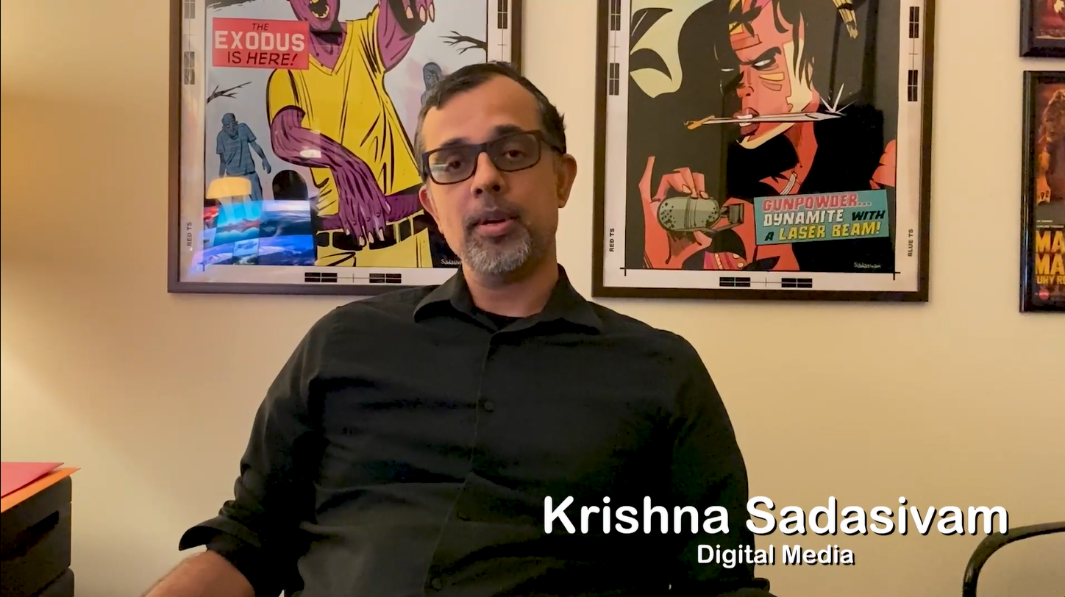
Faculty Voice
Notes:
Time: 3 minutes – 12:51-12:54
Speaker: Ashley
Notes:
https://spcollege.hosted.panopto.com/Panopto/Pages/Viewer.aspx?id=4c4fe85e-7144-4016-a71d-af5b01263a5e

Slide 10
Community of Inquiry
Social Presence
Ability to project the self socially and emotionally, thereby being perceived as “a real person” in mediated communication
Supports cognitive presence, facilitates critical thinking, allows learners to express themselves freely, build connections, and function as a cohesive group, leads to meaningful and engaging learning experience
Teaching Presence
Design, facilitation, and direction of the class to obtain optimal learning outcomes
Improve social and cognitive presence which in turn can lead to better educational outcomes
Cognitive Presence
Supported by a strong foundation of teaching and social presence.
Focuses on learners’ ability to construct meaning through continuous dialog and reflection
(DU Office of Teaching & Learning, 2022; Garrison et al., 2000; Singh et al., 2022)
Notes:
Time: 3 minutes – 12:54-12:57
Speaker: Janice
Notes:
The Community of Inquiry (CoI) model was developed from a study (2001) consisting of three key elements: Social Presence, Teaching Presence, and Cognitive Presence. They work together to impact a student's educational experience. Research has consistently demonstrated that intersection of three presences creates a strong positive learning experience for students in the online medium of instruction. When the student has a sense of community, they understand the purpose of learning, can contribute, can connect with other students, and can feel a sense of owning their learning.
Social:
Ability to project the self socially and emotionally, thereby being perceived as “a real person” in mediated communication.
Benefit: Supports cognitive presence, facilitates critical thinking, allows learners to express themselves freely, build connections, and function as a cohesive group, leads to meaningful and engaging learning experience
Consists of:
Communication between and with the instructor and all members of the class
Interaction with the instructor and all members of the class
Relation of a learning community throughout the term
Moves from introduction to community to camaraderie
Note: Social Presence is the main element needed before Cognitive and Teaching Presence can occur
Examples:
Ask the entire class to create welcome videos
Provide personalized, timely assignment feedback, such as media commenting
Active instructor engagement in online discussion boards; establishing presence
Encourage collaboration and exchange of ideas
Acknowledge student contributions and expertise
Establish group cohesion
Engage in supportive contact and interactions
Methods:
Welcome Note
Introduction
Communication
Blogs and Social Media
Personal Stories
Timely and Continuous Feedback
Teaching:
Design, facilitation, and direction of the class to obtain optimal learning outcomes.
Benefit: Improve social and cognitive presence which in turn can lead to better educational outcomes.
Consists of:
Instructional design, especially providing different methods of providing content
Organization of the course
Facilitation of the discussion
Moving the discussion through the four cognitive phases
Direct instruction and assisting students with questions and understanding
Note: Teaching Presence is a significant factor in student satisfaction and perceived learning
Examples:
Create a comprehensive syllabus that communicates clear expectations
Follow best practices in module structure/organization
Ensure that your course has an intuitive navigation
Provide detailed grading rubrics
Post Canvas announcements for weekly introductions and/or wrap-ups
Engage in effective and meaningful direct instruction
Be actively involved in discussions to facilitate dialogue
Provide timely, specific feedback on student performance
Methods:
Personalization
Open office hours and regular check in
Activities to raise awareness of technology
Meetings via zoom and use of webcam
Acknowledgment and peer support
Join virtual meetings early
Clear expectations
Cognitive
Supported by a strong foundation of teaching and social presence. Focuses on learners’ ability to construct meaning through continuous dialog and reflection.
Consists of:
Motivating students to cognitively engage with course content
A four-phase process
Triggering event such as an issue or problem
Exploration through reflection and discussion
Meaning construction as students discuss ideas
Application of knowledge both in the course and outside the classroom
Examples:
Discuss and introduce effective triggering events that create a sense of puzzlement
Promote information exchange
Create opportunities to connect ideas to prior learning and other course concepts
Provide knowledge from diverse sources
Create opportunities to foster meaningful application of new knowledge
Methods:
Communication
Mix of Assignments
Team work and discussions
Clear grading rubric and expectations
Respect diversity
Make connections
Invite Feedback
Include examples
Resources:
Critical Inquiry in a Text-Based Environment: Computer Conferencing in Higher Education: https://operations.du.edu/sites/default/files/2020-05/Garrison_Anderson_Archer_Critical_Inquiry_model.pdf
The Community of Inquiry Model: https://operations.du.edu/inclusive-teaching/community-inquiry-model
Establishing Social, Cognitive, and Teaching Presence in Online Learning—A Panacea in COVID-19 Pandemic, Post Vaccine and Post Pandemic Times: https://journals.sagepub.com/doi/full/10.1177/00472395221095169

Slide 11
Social
(Human Connections)
Cognitive (Meaning/Learning)
Introductory video from instructor
Check-in emails to see how we’re doing in the class
Weekly welcome emails
Instructor shares personal background and encourages students to share
Personal feedback and compliments
Asks for feedback about the course
Comments about how feedback on this assignment might be useful in their future careers
Teaching
(Design/Facilitation)
High quality videos with the instructor presenting the material
Personal feedback on assignments
Well organized course layout
Timely communication
Give students phone number
Notes:
Time: 10 minutes – 12:57-1:07
Speaker: Janice
Notes:
Google Doc: https://docs.google.com/document/d/1Wfd8DYBidDoYf-DYyzfObSOKKS0QS0lAOE4PZDQGVGQ/edit?usp=sharing

Slide 12
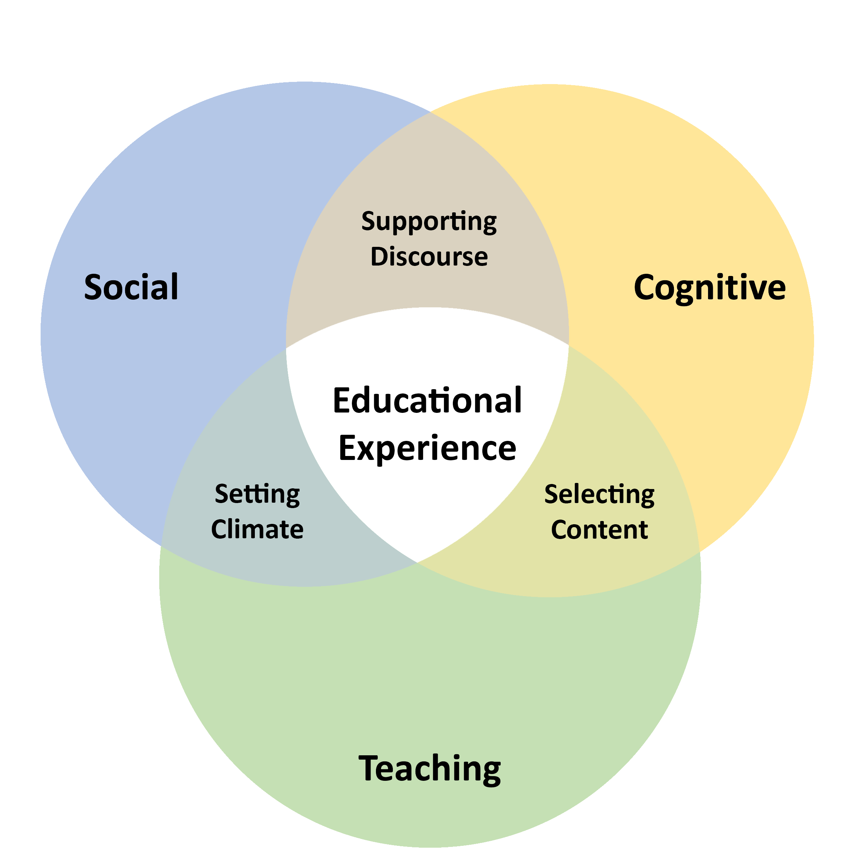
Social
Cognitive
Teaching
Notes:
Time: 10 minutes – 12:57-1:07
Speaker: Janice
Notes:

Slide 13
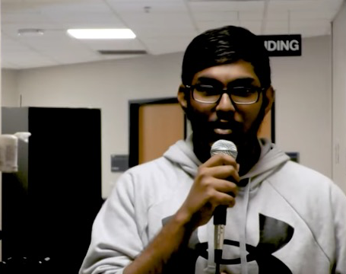
Student Voices
Notes:
Time: 3 minutes – 1:08-1:11
Speaker: Tim
Notes:
We're gathering stories from students about how they've experienced "presence" in their online classes, which is how relatable, engaged, involved, etc. faculty are in the course.
What did they do?
How did that make a difference?
Video: https://www.youtube.com/watch?v=i3_AWKLzzgc

Slide 14
Establishing Presence Plan
Q & A
Notes:
Time: 3 minutes – 1:11-1:14
Speaker: Nancy
Notes:
Establishing Presence Plan document:
Word: https://facultysupport.spcollege.edu/wp-content/uploads/2022/12/Establising-Presence-Plan.docx
PDF: https://facultysupport.spcollege.edu/wp-content/uploads/2022/12/Establising-Presence-Plan-1.pdf

Slide 15
Wrap Up
Topic | Webinar | Coffee or the Cup
Establishing Presence | 12/6/22 (Today!) | (combined)
Student Agency | 1/24/23 | 1/31/23
Community-Building | 2/21/23 | 2/28/23
Visual Appeal | 3/21/23 | 3/28/23
Accessibility | 4/18/23 | 4/25/23
Blog posts
Demos
Coffee or the Cup
Sharing Sessions
Website: FacultySupport.SPCollege.edu
Have an idea (or need one) for improving your course, but not sure where to start? Email us at IDEAS@SPCollege.edu
IDEAS Event Feedback Form: https://web.spcollege.edu/survey/34293
Notes:
Time: 1 minute – 1:14-1:15
Speaker: Nancy
Notes:
Copy into chat: IDEAS Event Feedback Form: https://web.spcollege.edu/survey/34293

